Slide 1
MACHINE LEARNING CLUSTERING Affinity Propagation Clustering

Slide 2
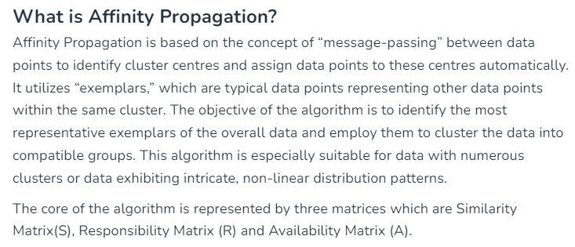

Slide 3
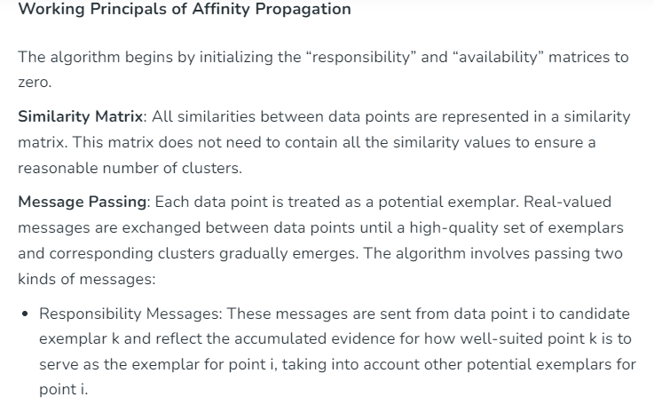

Slide 4
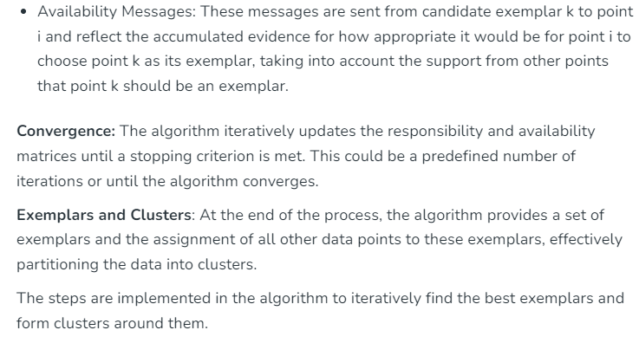

Slide 5
